Slide 1
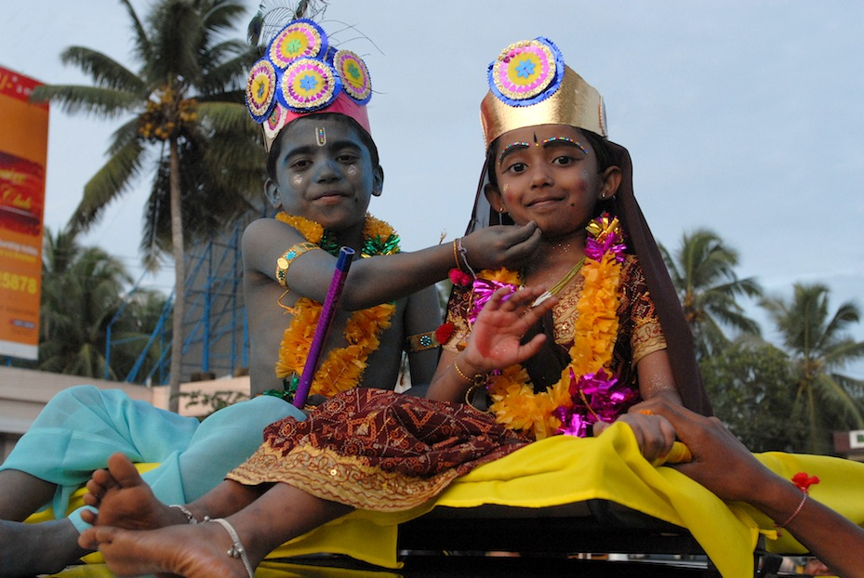
See the wonders of India with your own eyes…

Slide 2
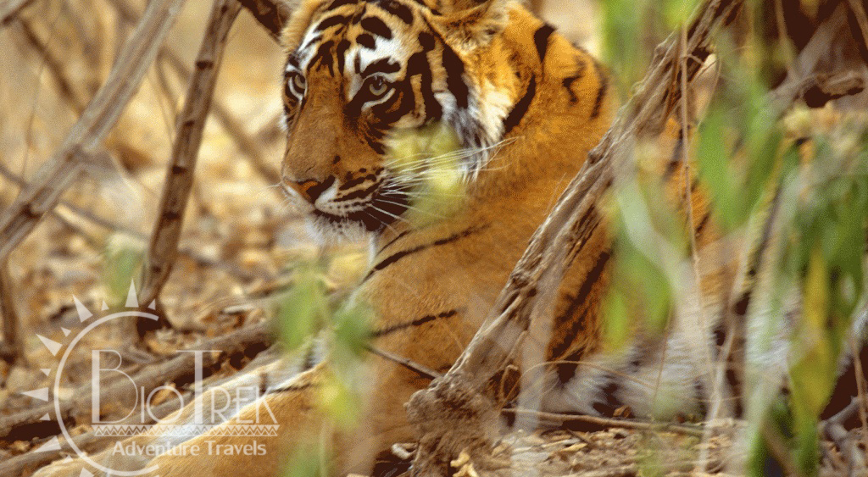
Let us be your guide…

Slide 3
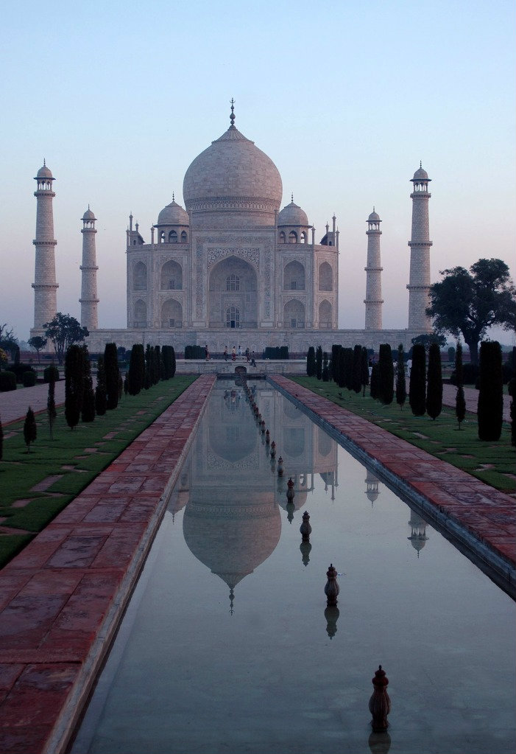
…so you can experience the magnificence of the Taj Mahal,

Slide 4
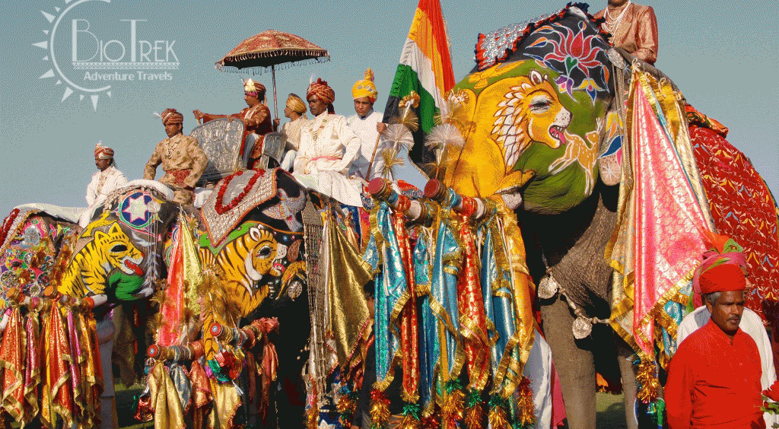
and the eye catching colors and rich culture of this incredible country.

Slide 5
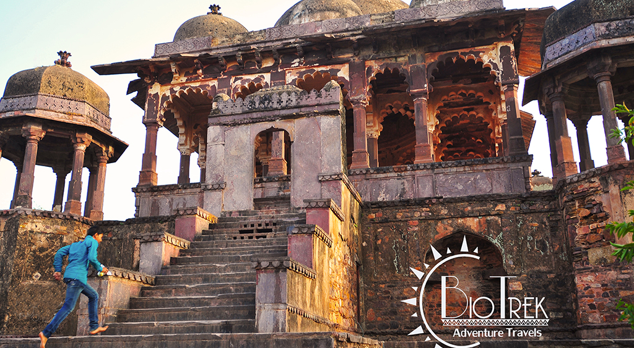
Time will not wait….

Slide 6
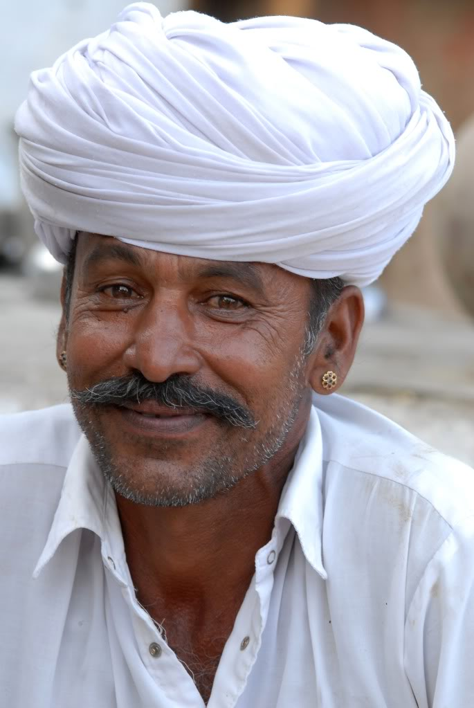

..and neither should you.
Tour leaves in March and will book fast,
contact us NOW!
www.BiotrekAdventureTravels.com
sunny@BiotrekAdventureTravels.com
540-349-0040

